Slide 1
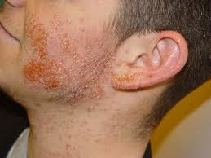
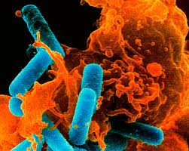
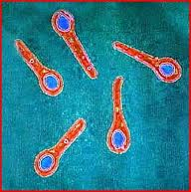
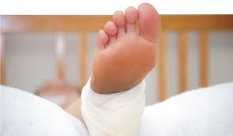
Infectious Diseases
Lesson 4.1

Slide 2
Where are we heading…..
Unit 1: What is an infectious disease and why do we care?
Unit 2: What does it mean to have an infectious disease?
Unit 3: When does a microbe become pathogenic?
Unit 4: How do pathogens make us sick?
Unit 5: How do we get better?

Slide 3
Lesson Objectives:
After finishing today’s lesson, you will be able to:
identify symptoms commonly caused by an immune response to infection.
distinguish between direct and indirect host cell damage.
give one example of how intracellular and extracellular bacteria lead to host damage and symptoms.
give one example of how slow and fast bacterial replication leads to host damage and symptoms.

Slide 4
Do Now
Brainstorm symptoms of the flu (viral infection) and strep throat (bacterial infection):
Flu symptoms | Strep throat symptoms

Slide 5
Are all the symptoms disease-specific?
Flu symptoms | Strep throat symptoms
Fever Cough Sore throat Runny or stuffy nose Body aches Fatigue Headaches Vomiting | Fever Difficulty swallowing Sore throat Red and swollen tonsils Body aches Rash Headaches

Slide 6
Are all the symptoms disease-specific?
These symptoms are not pathogen-specific and can be caused by numerous agents affecting the same body organs or are the result of a more general response of the body to pathogens.

Slide 7
Discussion
How do pathogens cause these symptoms?

Slide 8
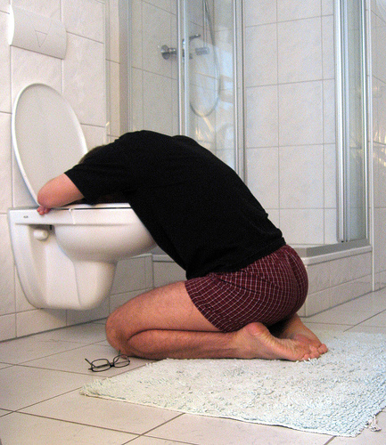
Pathogens cause symptoms in two major ways:
They stimulate the immune system causing inflammation (Unit 5)
When the immune response clears an infection it can cause swelling, pain, redness, and heat/fever.

Slide 9
2. They damage the host cells and disrupt host functions by:
Direct damage to host cells.
When the pathogen replicates in host cells.
When the pathogen releases factors like toxins that damage host cells/organs. (Lesson 4.2)
Indirect damage to host cells by activating the immune system. (Unit 5)
When immune cells kill infected host cells and healthy cells near the infection.

Slide 10
How might the location of pathogen replication impact symptoms?
Extracellular
Intracellular

Slide 11
Both extracellular and intracellular bacteria damage the host in direct and indirect ways
Extracellular
Migrate to new locations
Survive in more hostile environments
Less dependent on host cell
Direct or indirect damage with toxins or enzymes
Indirect damage if the immune system damages healthy host cells while trying to eliminate the pathogen from the body
Intracellular
Hide from host defenses
Utilize host resources
Direct damage as they use the nutrients of the host cell and destroy it
Indirect damage if the immune system recognizes a host cell is infected and kills it or if it damages healthy cells around the infected

Slide 12
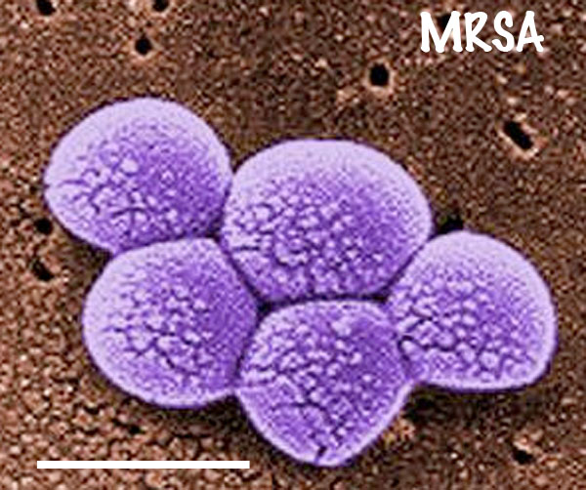
Extracellular pathogens can often adapt to many environments (because they can move)
Staphylococcus aureus

Slide 13
This means that extracellular replication can be anywhere casing a wide range of symptoms
Staphylococcus aureus
Skin infections (cutaneous)
Bloodstream infections
Surgical site infections
Pneumonia

Slide 14
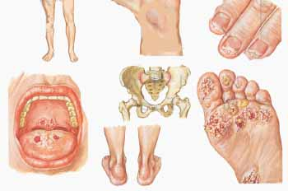
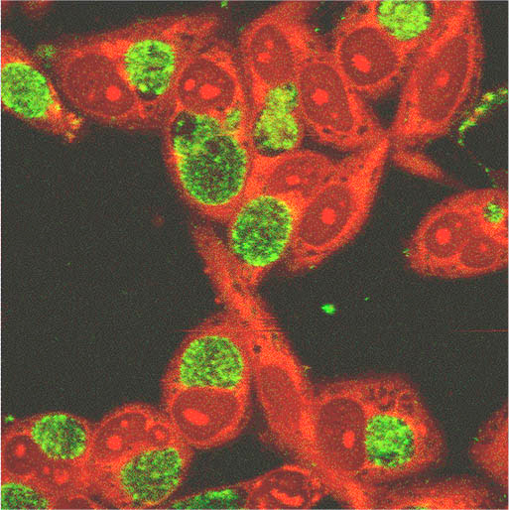
Intracellular replication is cell type restricted
Damages to
host tissues
Chlamydia trachomatis is the leading cause of bacterially transmitted STDs – 4 million cases in the US annually!
Chlamydia bacteria (green dots) detected
in host cells (red)

Slide 15
This means that the location of intracellular infections and their symptoms are predictable
Damages to
host tissues
Chlamydia trachomatis is the leading cause of bacterially transmitted STDs – 4 million cases in the US annually!
Chlamydia bacteria (green dots) detected
in host cells (red) – genitals, bottoms of feet,
fingertips, and around the mouth

Slide 16
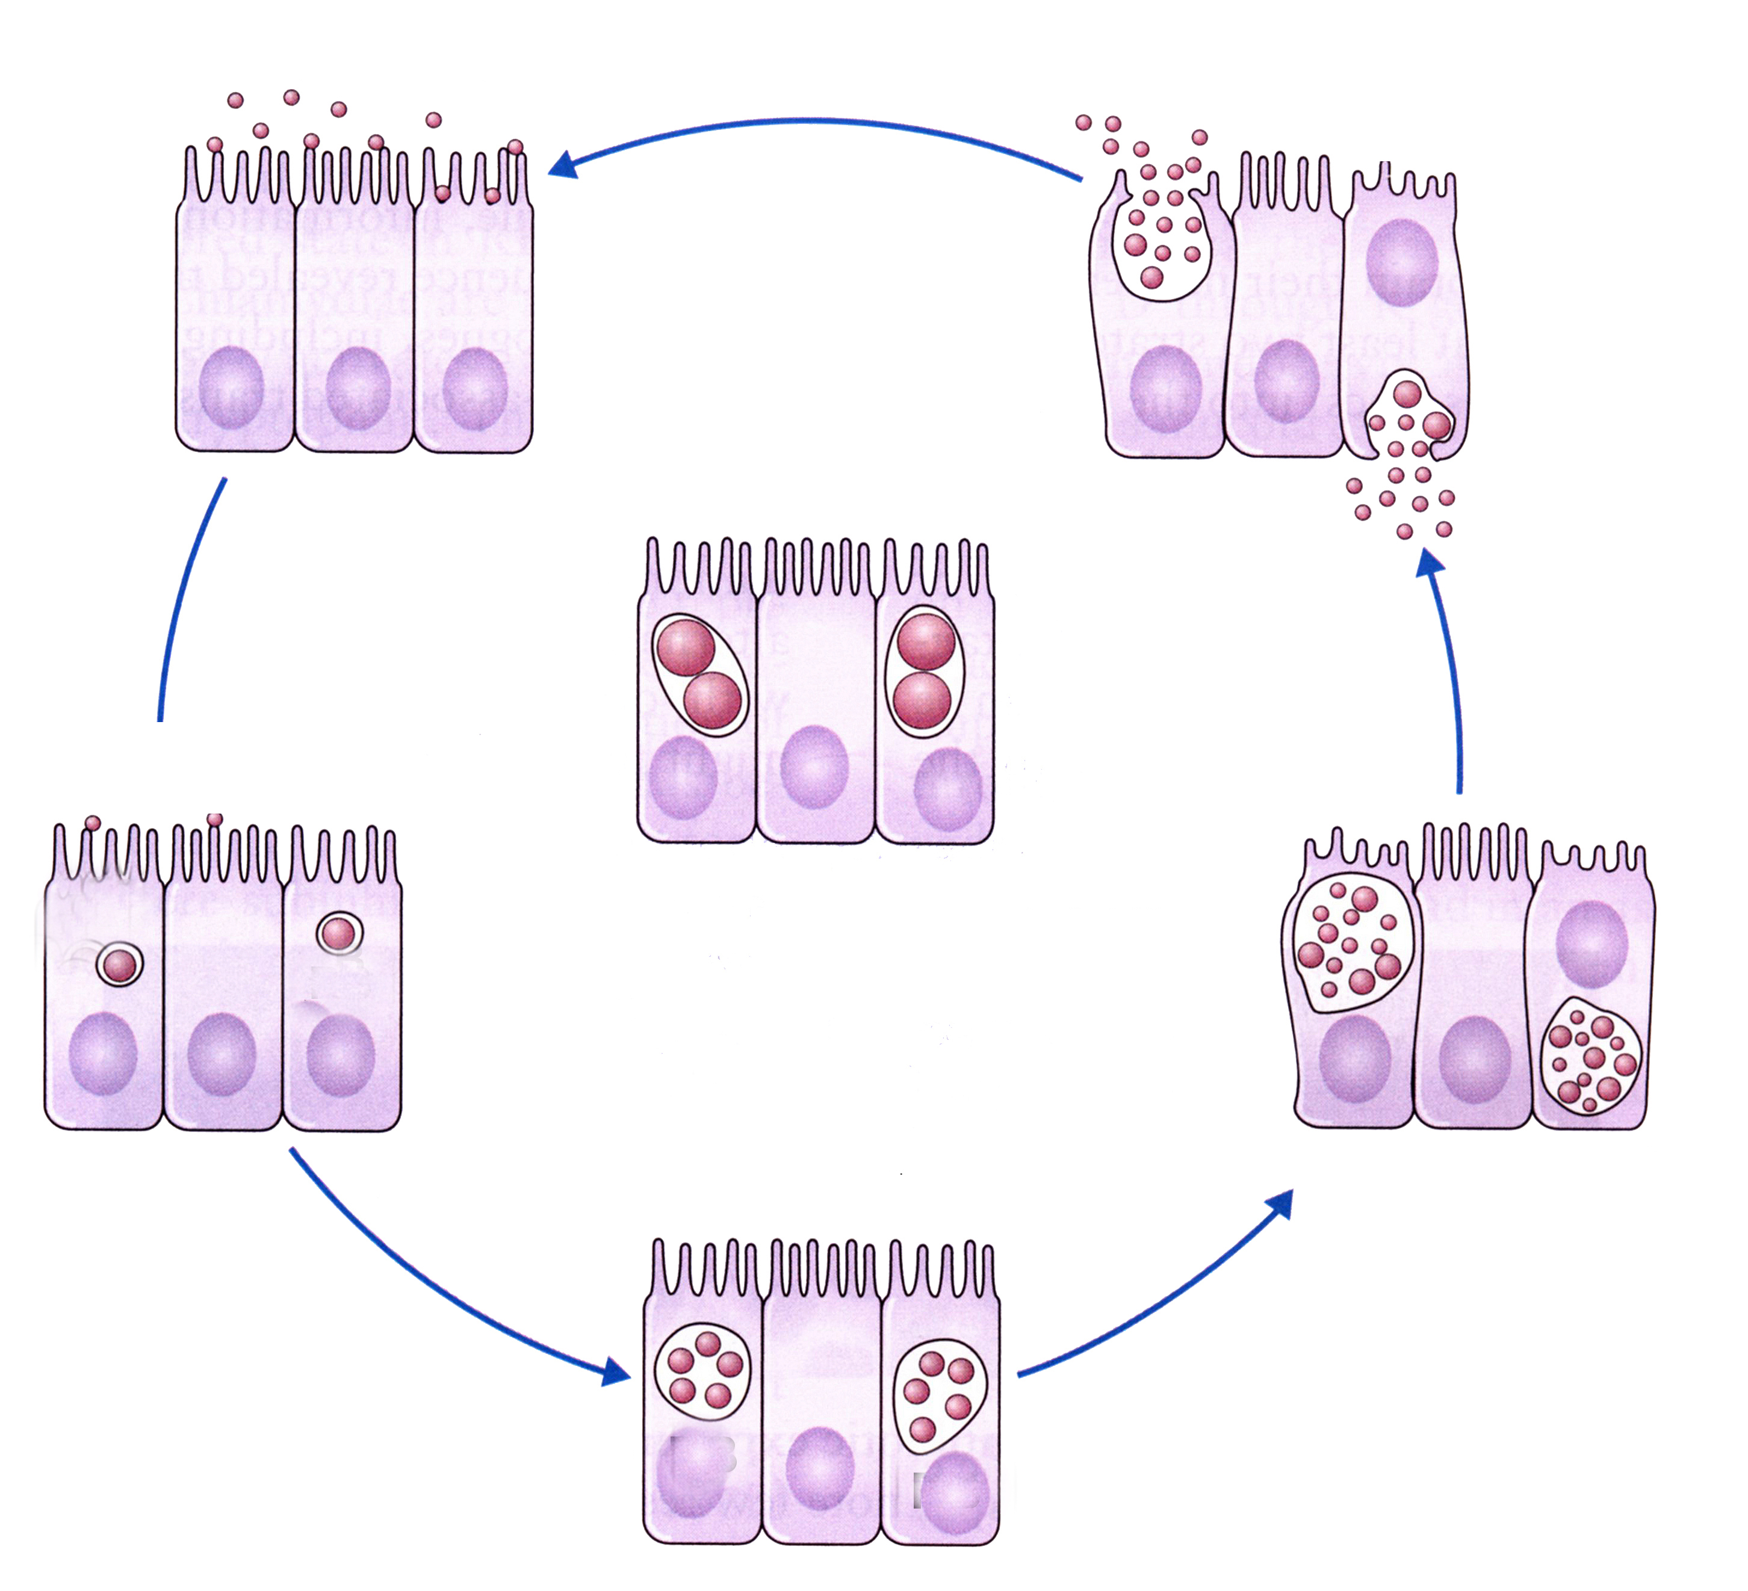
How Chlamydia replicates inside cells
animation
7. Bacteria spread to new cells and hosts
1. Extracellular bacteria attach to host cells
6. Bacteria damage and leave the host cell
2. Bacteria enter the host cells
3. Bacteria hide in vesicles and replicate
5. Replication starts
again until host
nutrients are exhausted
4. Replication can stop to hide from the immune system

Slide 17
Chlamydia can only replicate in and damage select cells
This causes the disease-specific symptoms

Slide 18
How might the rate of pathogen replication impact symptoms?

Slide 19
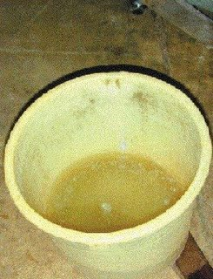
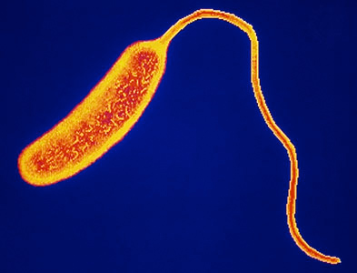
Fast replication causes acute (severe/sudden) illness which may kill the host
Sack et al., 2004
Cholera
Vibrio cholerae
Watery diarrhea
For example, V. cholera leads to rice water diarrhea, as the bacteria replicate quickly in the intestines and produce high levels of the cholera toxin, which causes the intestinal cells to leak water and ions leading to fatal dehydration.
Causes both extracellular and intracellular damage

Slide 20
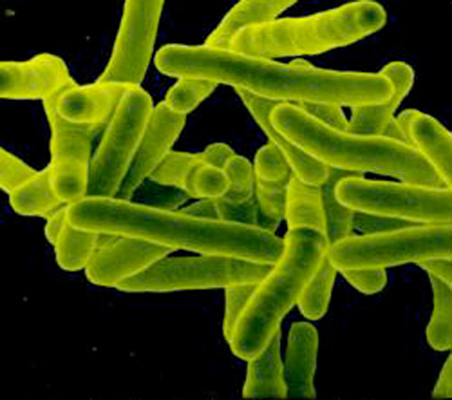
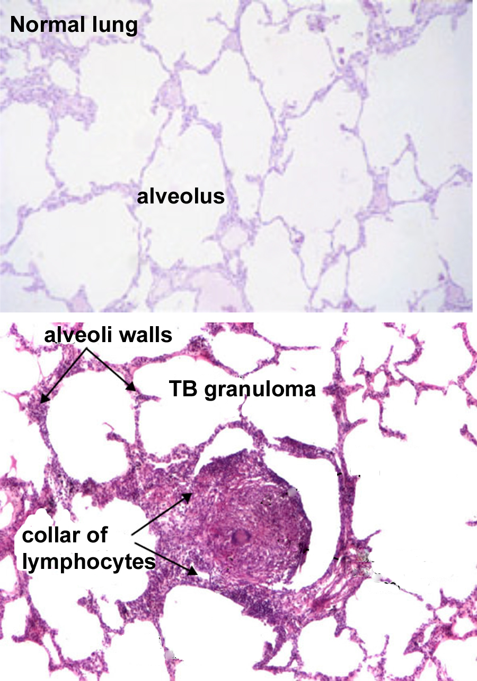
Slow replication can cause latent/ chronic illness which may not lead to death
Mycobacterium tuberculosis (causes TB)

Slide 21
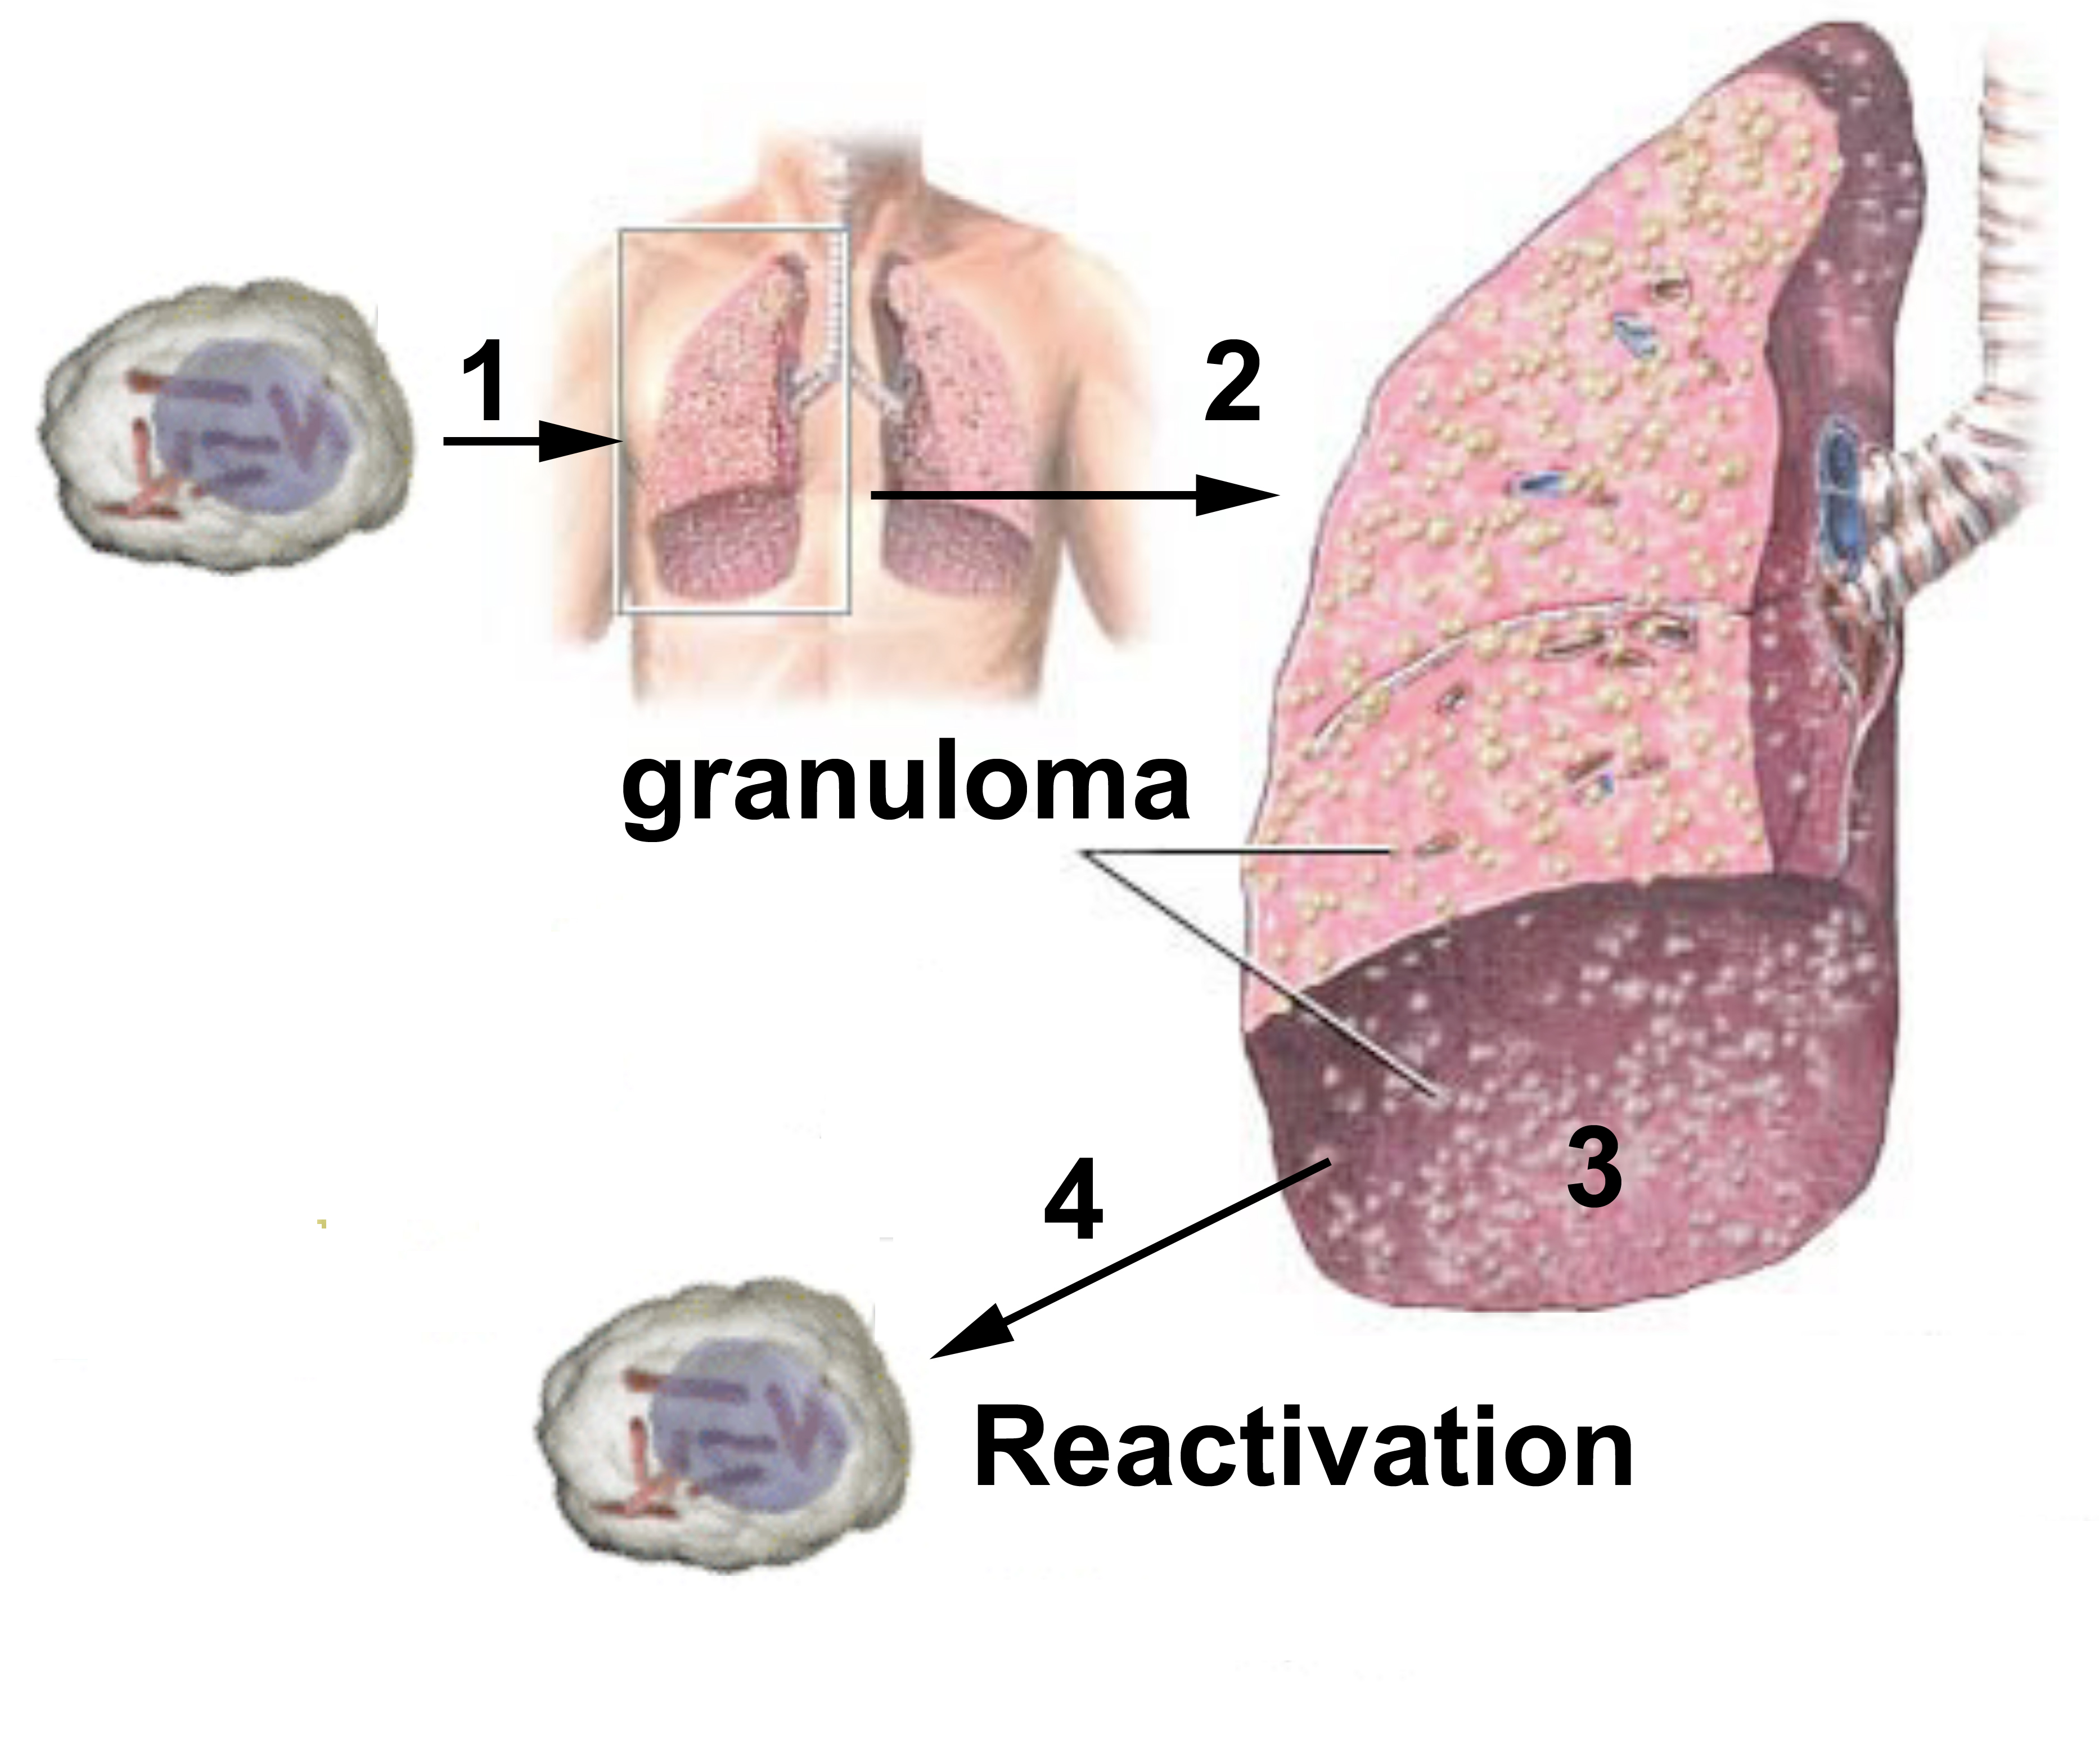
TB bacteria can hide for years causing NO symptoms, until conditions are right
Causes both extracellular and intracellular damage

Slide 22
Wrap Up
 | Symptoms | Damage | Example
Extracellular | Replicate anywhere causing a wide range of symptoms | Direct or indirect damage with toxins or enzymes Indirect damage if the immune system damages healthy host cells while trying to eliminate the pathogen from the body | S. aureus
Intracellular | Replicate in select cells causing more disease-specific symptoms | Direct damage as they use the nutrients of the host cell and destroy it Indirect damage if the immune system recognizes a host cell is infected and kills it or if it damages healthy cells around the infected | Chlamydia
Fast replication | Usually cause severe acute symptoms | Both types of damage | V. cholerae
Slow replication | Usually cause chronic infections | Both types of damage | M. tuberculosis

Slide 23
Homework
Read about how bacteria produce toxins (Lesson 4.2, Jigsaw Reading).

